Slide 1
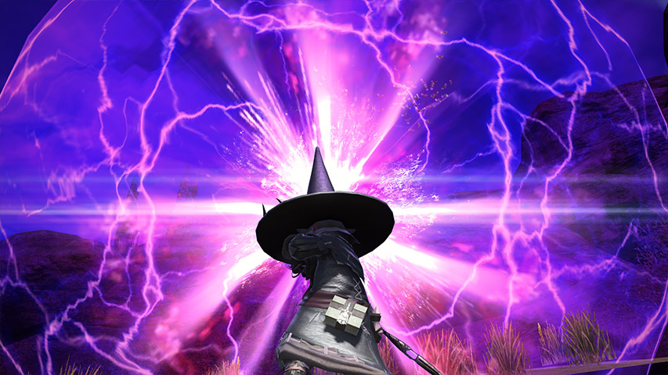
ELDERS!
A Final Fantasy xiv arr: Recruitment Site
Looking for:
Mature, PST players with MMO experience.

